Slide 1

CSCI 476: Computer Security
Review, Lessons learned
Reese Pearsall
Fall 2024
*all images are stolen from the internet
https://www.cs.montana.edu/pearsall/classes/fall2024/476/main.html

Slide 2
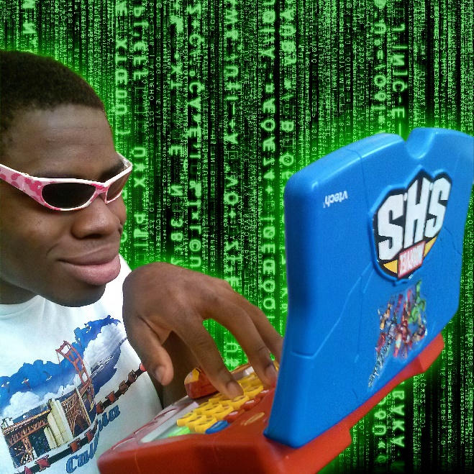
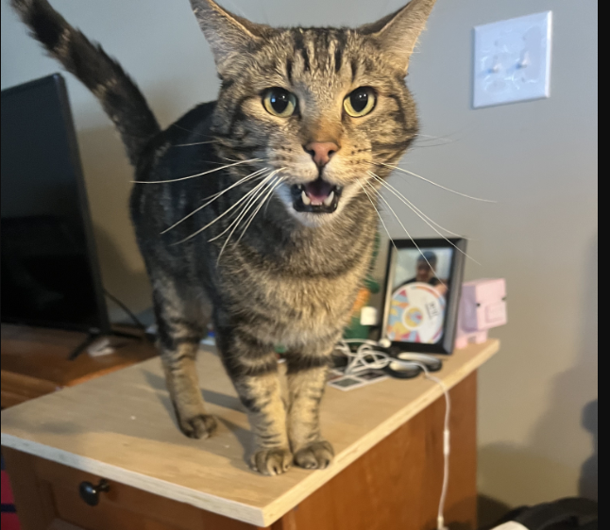
Announcements
students after completing CSCI 476
Lab 9 due Sunday 12/8
Final Exam
Tuesday December 10th 2:00 – 3:50 in Romney 315
Please be there
Meatball wishes you good luck on your final exams

Slide 3


Slide 4
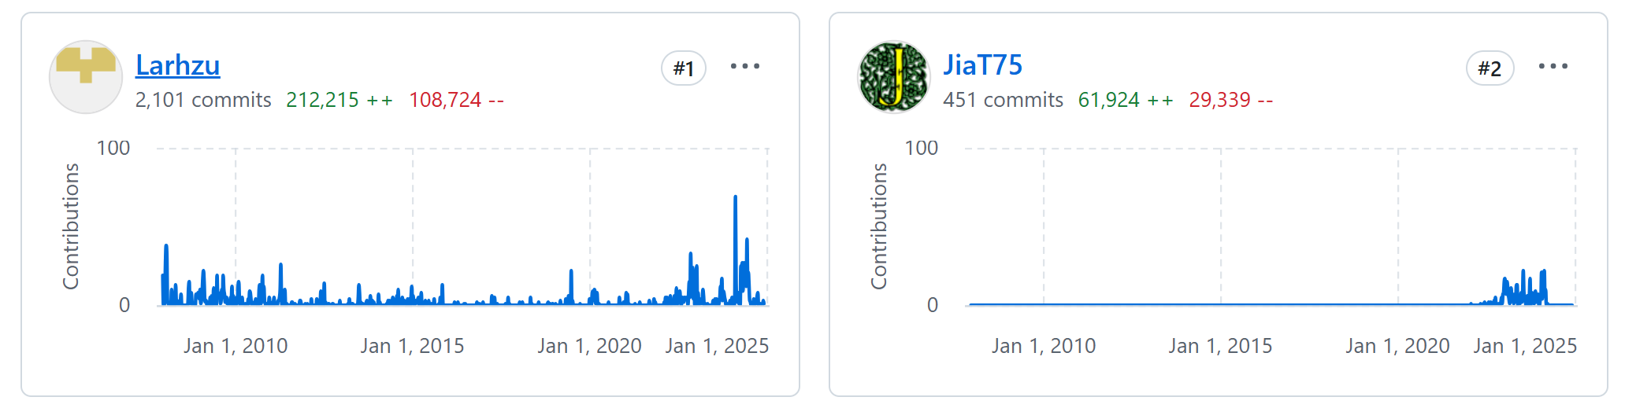
Story Time
XZ Utils is a Linux compressing library that exists on most Linux systems
This is an open-source library, however it is mostly maintained by Lasse Collin (Larhzu)
In 2022, Jia Tan (JiaT75) begins contributing towards the open-source projects and gains the trust of Lasse
Lasse begins to feel overwhelmed by this project with its increased usage and development

Slide 5

Story Time
XZ Utils is a Linux compressing library that exists on most Linux systems
However, Jia Tan has malicious intentions.
Through a series of complex obfuscations, a disguised test file is used to inject code into the build process of executables for XZ Utils
This injected code would break authentication for sshd, and allow someone to remotely login to these compromised machines, thus creating a backdoor
A library that most Linux machines use would install a backdoor onto the system, allowing a threat actor to remotely connect to it

Slide 6

Story Time
XZ Utils is a Linux compressing library that exists on most Linux systems
Andres Freund, a Microsoft Engineer, ended up discovering the vulnerability in March of 2024
Andres noticed that SSH’ing into his machines was taking slightly longer, and using more computational resources than normal
This caused him to inspect the source code to find the cause of this problem. He eventually stumbled upon this backdoor in the XZ library and immediately reported it
CVE 2024 3094
The vulnerability was fixed shortly after that

Slide 7
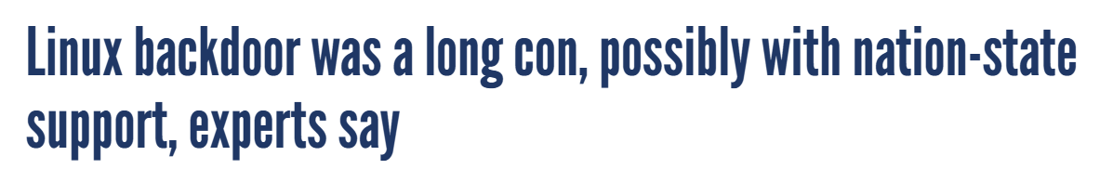
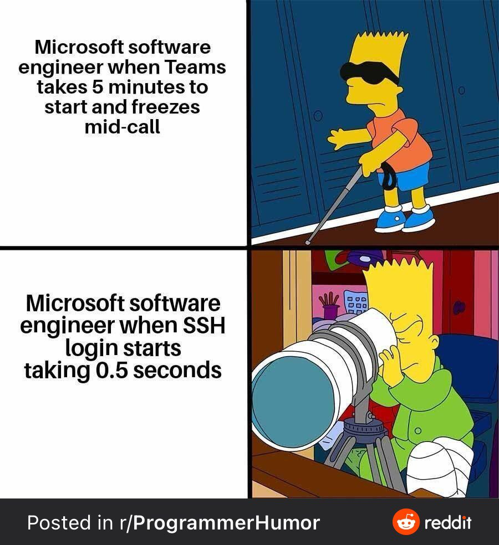
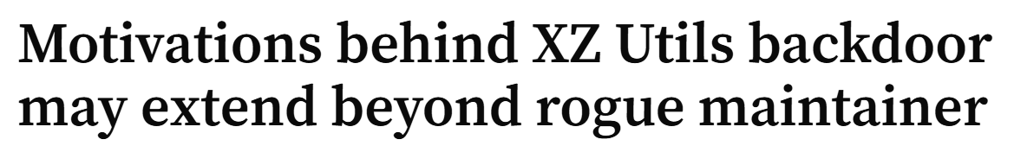
Story Time
Jia Tan has vanished since the incident

Slide 8
Final Exam Logistics
Tuesday, December 10th 2PM – 3:50 PM in Romney Hall 315
15% of your final grade
You are allowed to use one notesheet (8.5 x 11, both sides)
Can be handwritten or typed
The exam will be about 15 questions
14 short answer questions that can be answered in 1-3 sentences
1 question where you will develop a threat model for a software system
Study guide can be found on the course website

Slide 9
CSCI 476 Timeline
August
October
November
Software Security | Web Security | Network Security | Cryptography
Look at a variety of attacks in the realm of software security, web security, network security, cryptography
→ Learn the countermeasures for these attacks (and how effective they are)

Slide 10

SET-UID Programs
A SET-UID Program allows a user to run a program with the program owner’s privilege
User runs a program w/ temporarily elevated privileges
Every process has two User IDs
Real UID (RUID)– Identifies the owner of the process
Effective UID (EUID)– Identifies current privilege of the process
If a program owner == root,
The program runs with root privileges
Methods of Attack
Unsafe Function Calls (system() vs exec() )
Overwriting important ENV variables (PATH)
Overwriting important linking ENV variables (LD PRELOAD)

Slide 11
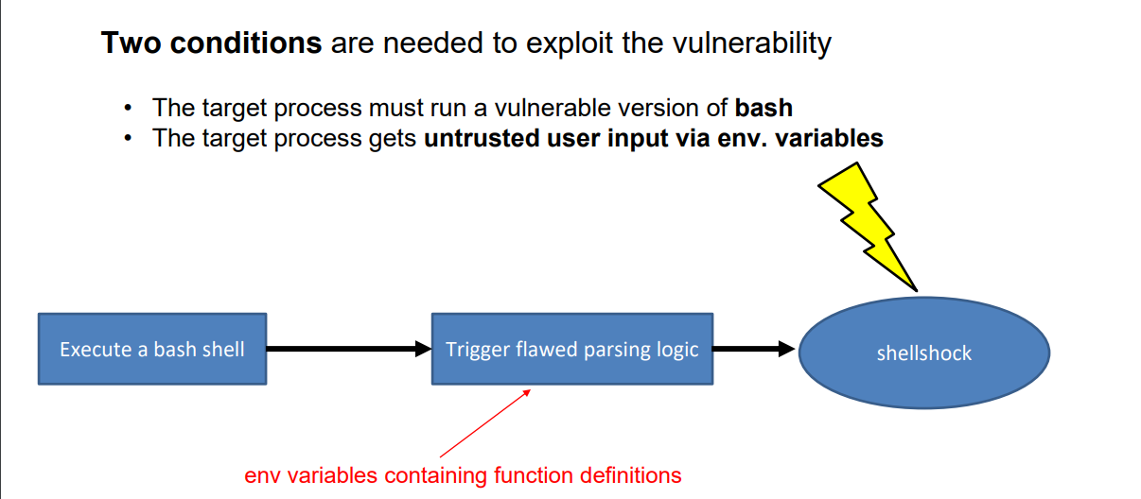
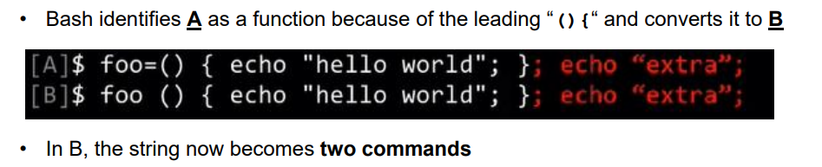
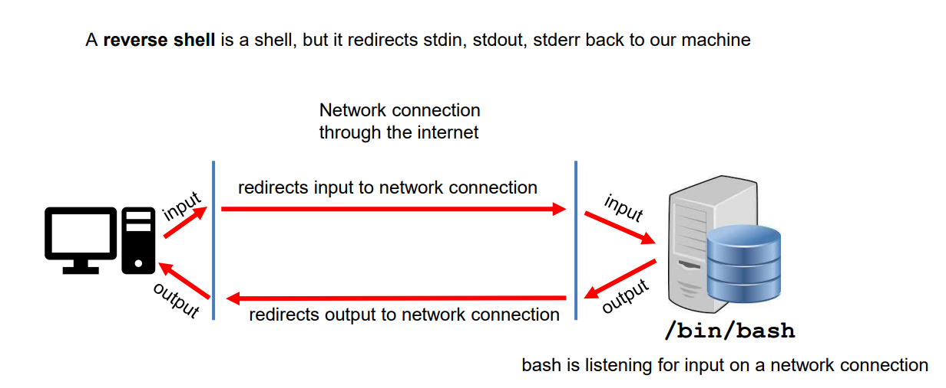
Shellshock Attack
Due to parsing logic in a vulnerable version of bash, we can export an environment variable that bash will interpret as a shell function
Example Payload

Slide 12
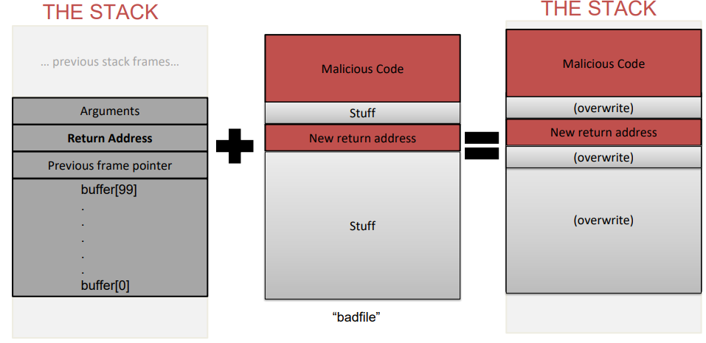
Buffer Overflow
When a program unsafely writes data to the stack via some buffer, we can overflow the buffer with our data
If we are smart, we can overwrite the return address and have the code jump to our malicious function
Countermeasures:
Secure Shell (/bin/dash)
ASLR
Stack Guard
Non-Executable Stack
To find the important locations in our stack, we used $ebp and $esp
The malicious code that we injected was shellcode
How did we bypass these countermeasures?
We filled overwrote everything else with NOPs

Slide 13
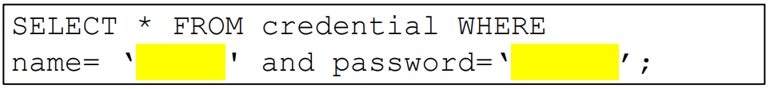
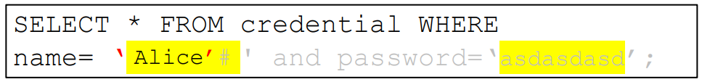
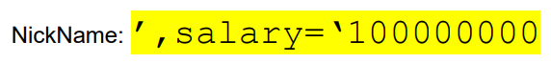
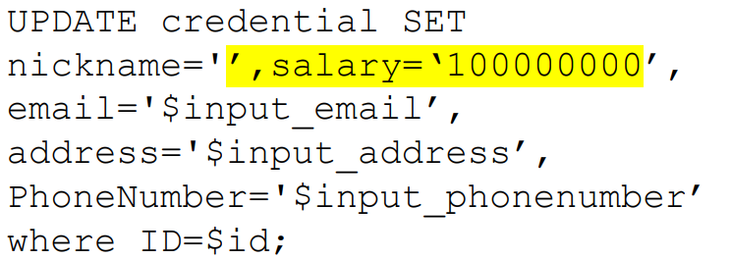
SQL Injection
It is common for user input to be inserted into a back-end SQL query. If an application is not careful about sanitizing user input, a user could supply an input that could be interpreted as SQL code and will interfere with the query
Username = Alice’#
Password = asdasdasd
Countermeasure: SQL Prepare() statements

Slide 14
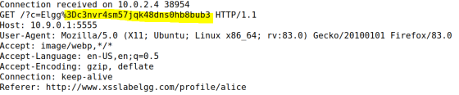
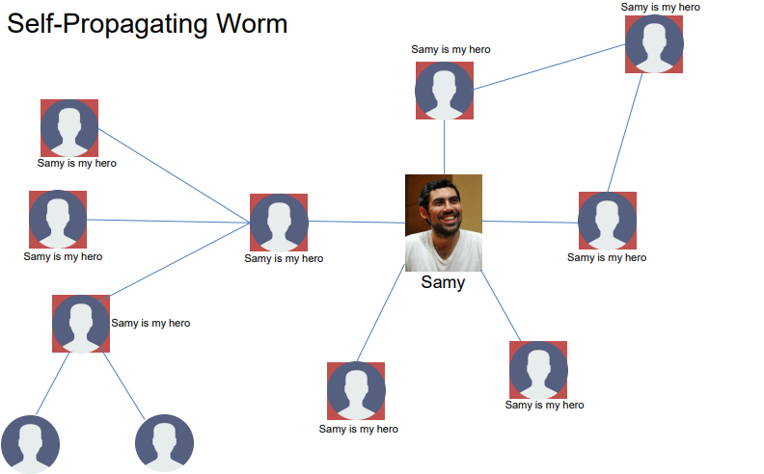
XSS Attack
Goal: Get someone else’s browser to execute our own JavaScript code
Vulnerability: Unsafe user input handling, and unsafe web communication policies
netcat server
Countermeasures:
Filtering
Encoding
CSP, CORS

Slide 15
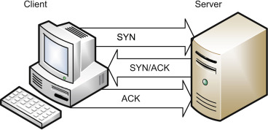
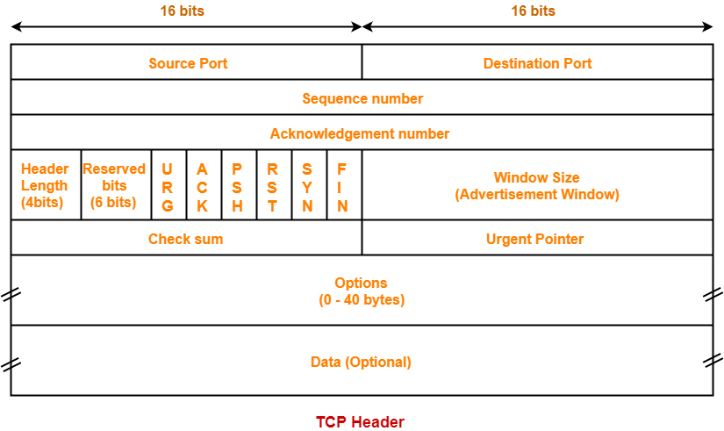
TCP Attacks
TCP Flooding- spoof a bunch of packets with bogus source IP addresses with the SYN flag. The server thinks these are legitimate requests and allocates computational resources for the request. We flood a server with these until the server can no longer accept new requests (and essentially denying service)
TCP Reset- Break an existing TCP connection by spoofing a TCP RST packet that looks like it came from one of the people in the existing TCP connection.
TCP Hijack- Hijack an existing TCP connection to get a TCP server to execute arbitrary commands. Spoofed a packet with the correct information so that the server thinks it came from the client

Slide 16



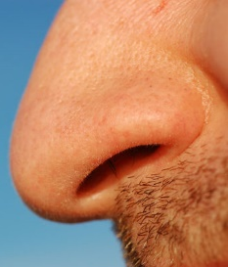

DNS Poisoning
A DNS cache poisoning attack is done by tricking a server into accepting malicious, spoofed DNS information
Instead of going to the IP address of the legitime website, they will go to the IP address that we place in our malicious DNS response (spoofed)
Internet
10.9.0.5
Client Container
10.9.0.53
Local DNS Server
Spoofed DNS
Response
Spoofed DNS
Response

Slide 17
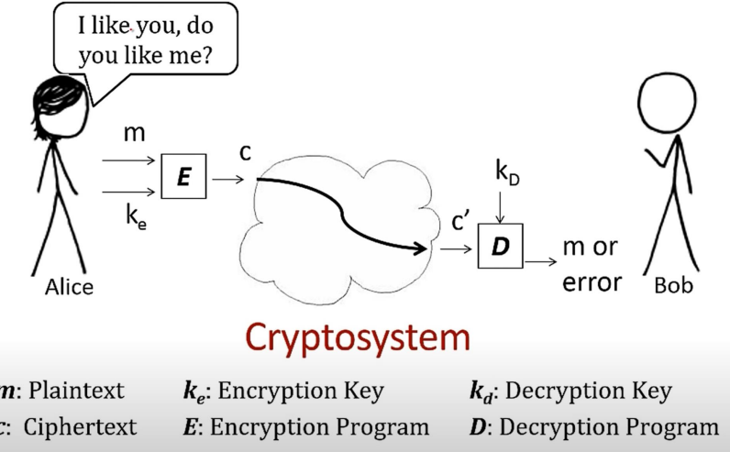

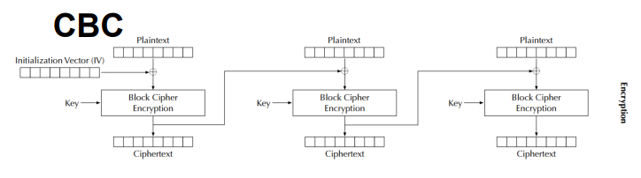
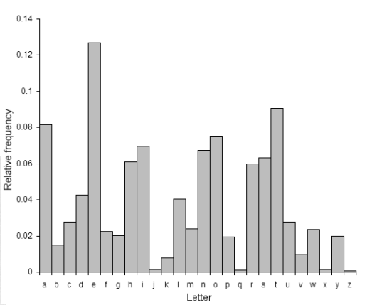
Symmetric Cryptography / Secret Key Encryption
Block Cipher (AES)
→ Split messages into fixed sized blocks, encrypt each block separately
Hello there world
01101000 01100101 01101100 01101100 01101111 00100000 01110100 01101000 01100101 01110010 01100101 00100000 01110111 01101111 01110010 01101100 01100100 00001010
Padding gets applied if the plaintext is not a multiple of the block size
Block 1
Block 2 Block 3
Frequency Analysis
(as a way to crack substitutions ciphers)
Ciphertext
An initialization vector (IV) is an arbitrary number that can be used with a secret key for data encryption
Modes of encryption: ECB, CBC, CFG, CTR, CFB

Slide 18
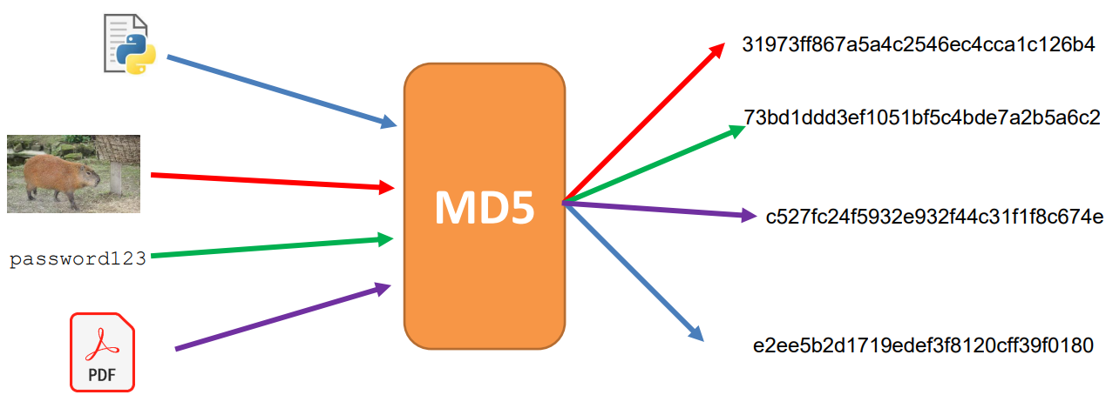
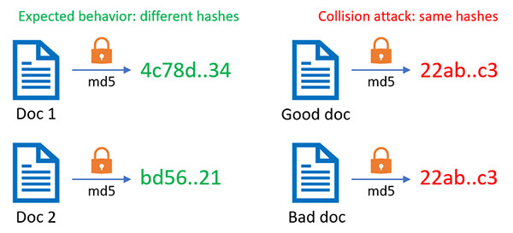
Hashing
Properties of Cryptographic Hash Function:
Given a hash, it should be difficult to reverse it
Given a message and its hash, it should be difficult to find another message that has the same hash
In general, difficult to calculate two values that have the same hash
Hash Collisions occur when two inputs map to the same hash, which can have some scary consequences
Applications of Hashing:
Message Integrity
Password Storing
Fairness and Commitment
Birthday Paradox

Slide 19
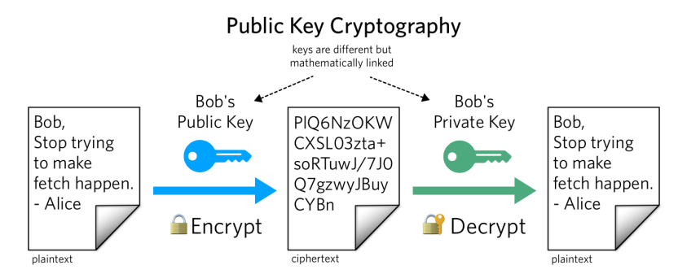
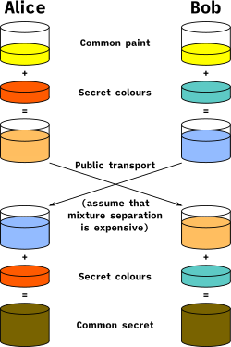
Asymmetric Cryptography / Public Key Encryption
Public Key vs Private Key (Mathematically linked)
Public key used to encrypt; Private key used to decrypt
Alice knows the prime products that generated her key, so it’s very easy for her to factorize
Eve does not know the products, and it is computationally infeasible for her to calculate the integer factorization of very large number
Diffie Helman Technique is used to transport a secret over an unsecure channel
RSA can not encrypt stuff that is larger than its key size,
So we typically will encrypt the key for a symmetric encryption algorithm (AES)
Private Keys are also used for digital signatures, which can be used to authenticate a message

Slide 20
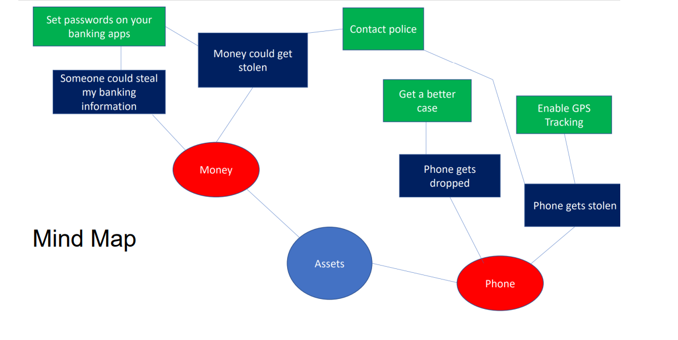
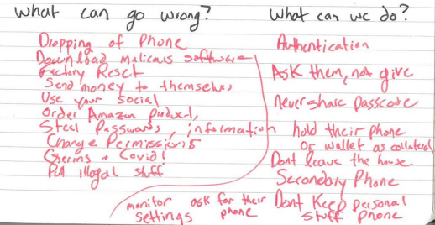
Threat Modeling
Threat modeling is a structured approach to assessing risk and defenses
What are you building?
What are the assets?
What can go wrong?
What should you do about those things that can go wrong?
Did you do a decent job of analysis?

Slide 21
Sample Test Questions
What is an SQL injection? What is the goal of an SQL injection attack?

Slide 22
Sample Test Questions
What is an SQL injection? What is the goal of an SQL injection attack?
An SQL injection is vulnerability where an attacker manipulates the structure and behavior of an SQL query by injecting malicious input into it. The goal is typically to gain unauthorized access into a database, alter data, or delete data

Slide 23
Sample Test Questions
How did we use XSS to steal a victim’s web cookies?

Slide 24
Sample Test Questions
How did we use XSS to steal a victim’s web cookies?
We injected a bogus image that will be loaded by the victim’s browser. When the HTTP request is made to the bad actor’s IP address, the cookies are attached as a header.

Slide 25
Sample Test Questions
What is a reverse shell? Why did we need a reverse shell during the shellshock attack instead of a normal shell?

Slide 26
Sample Test Questions
What is a reverse shell? Why did we need a reverse shell during the shellshock attack instead of a normal shell?
A reverse shell is like a normal shell, but standard input, output and error are redirected to a remote machine through a TCP connection. When shellshock created a shell on the victim server (/bin/sh), we needed to be able to control the inputs and outputs of the shell remotely, thus requiring a reverse shell

Slide 27
Sample Test Questions
Why did we need to provide the sequence number in the TCP reset attack?

Slide 28
Sample Test Questions
Why did we need to provide the sequence number in the TCP reset attack?
A TCP server reads data in a specific order. If we provide a sequence number that is earlier/later than the server is expecting, the packet will be discarded, so we must be exact.

Slide 29
CSCI 476 Course Outcomes
Understand important principles of security and threats to the CIA triad
Understand a variety of relevant vulnerabilities and defenses in software security (SETUID, Shellshock, Buffer Overflow)
Understand a variety of relevant vulnerabilities and defenses in network/web security (SQL Injection, XSS, TCP/IP attacks)
Understand a variety of relevant vulnerabilities and defenses in cryptography (Asymmetric, symmetric, One Way Hashing)
Given a system, develop a threat model, assess potential security weaknesses, and be able to think from the perspective of a threat actor
Make technical decisions during development of software with security in mind

Slide 30
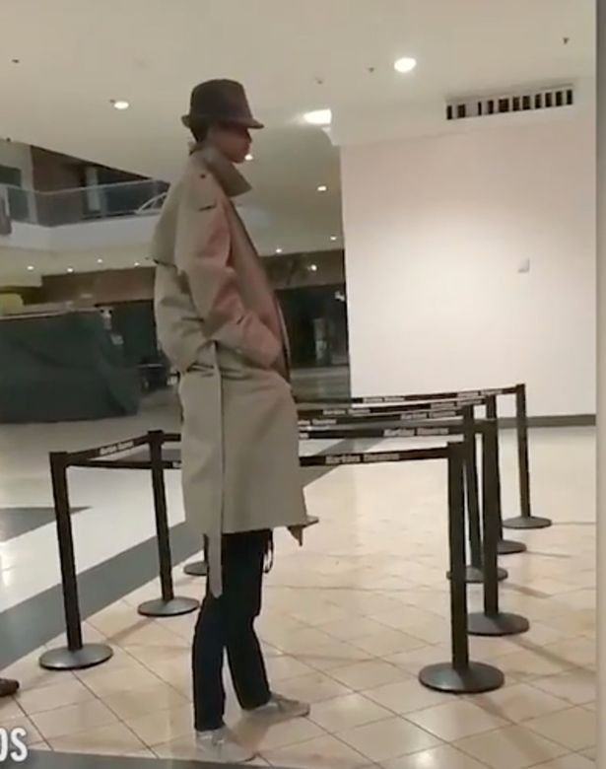


Takeaways
Trust- Trust as little as possible. We never know for sure how a user will interact with software

Slide 31
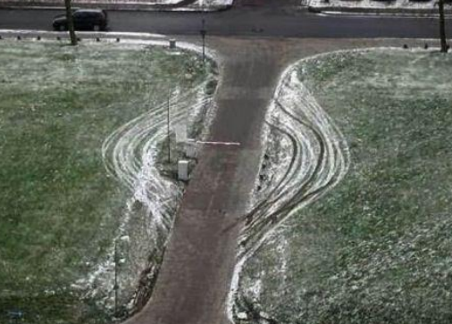
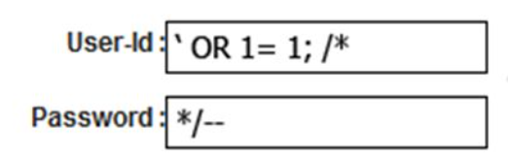
Takeaways
Trust- Trust as little as possible. We never know for sure how a user will interact with software
Intended Design- Users may interact with out system in ways that we did not think of.

Slide 32

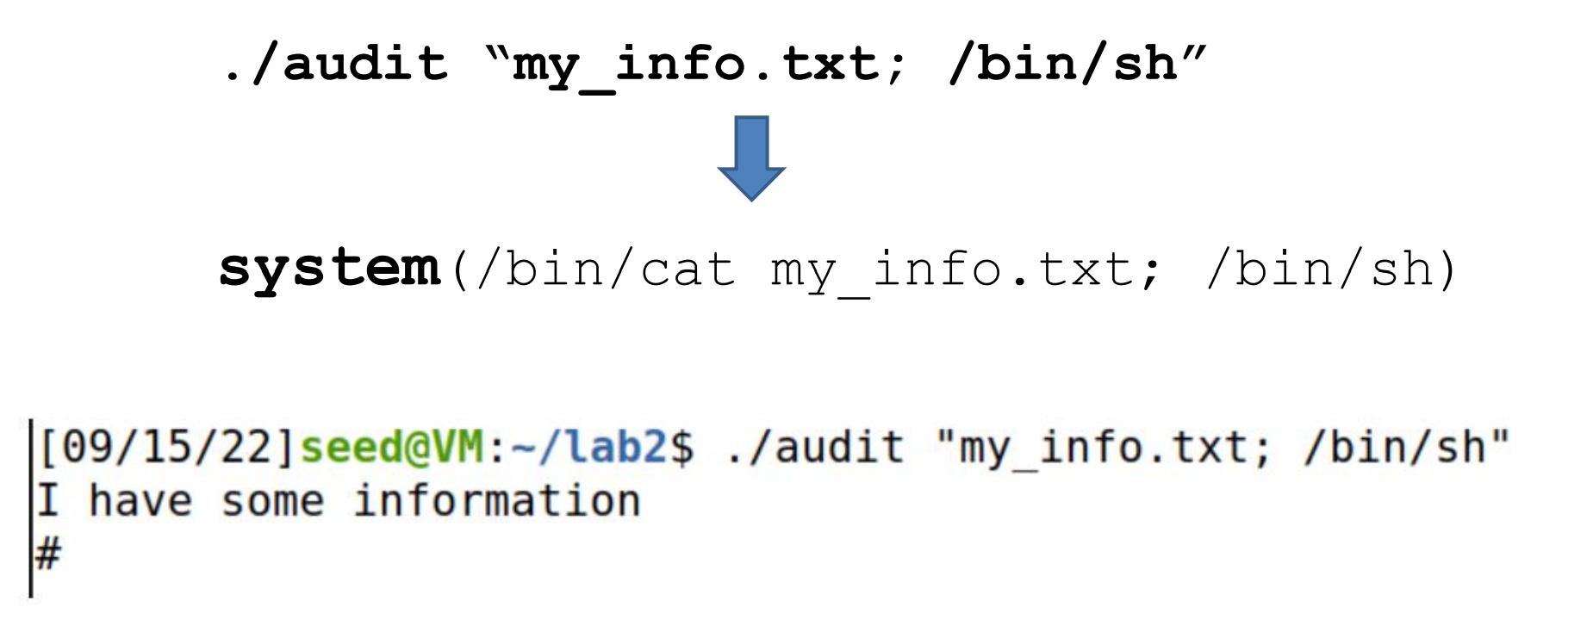
Takeaways
Trust- Trust as little as possible. We never know for sure how a user will interact with software
Intended Design- Users may interact with out system in ways that we did not think of.
Separation- There should always be a clear separation of code and data (user input)

Slide 33
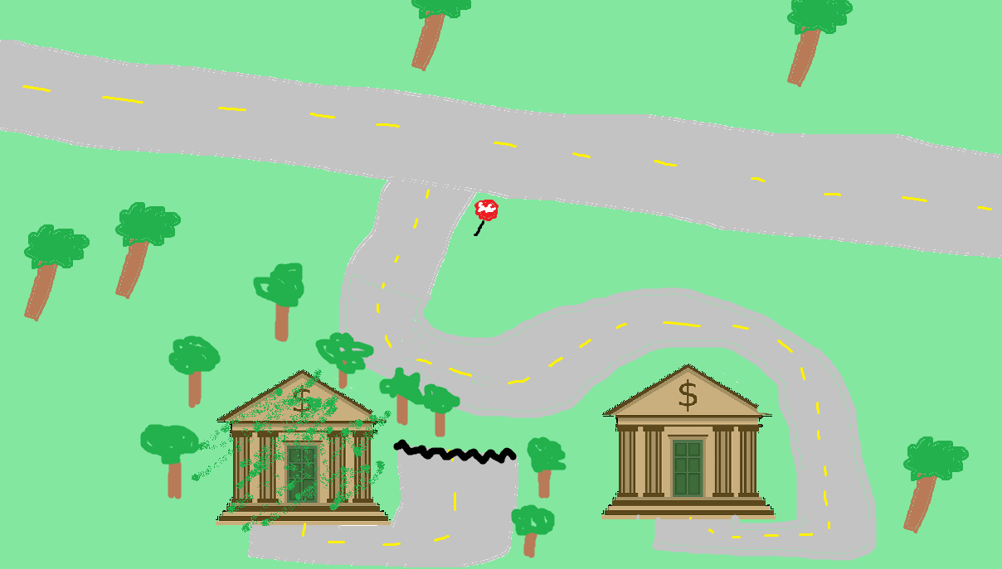



Takeaways
Trust- Trust as little as possible. We never know for sure how a user will interact with software
Intended Design- Users may interact with out system in ways that we did not think of.
Separation- There should always be a clear separation of code and data (user input)
Control Flow Hijack- There should not be any way for an attacker to hijack the “natural flow of things”
Malicious Website
10.9.0.5
Client Container
10.9.0.53
Malicious DNS Server

Slide 34

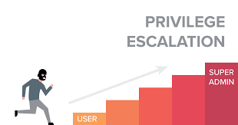
Takeaways
Trust- Trust as little as possible. We never know for sure how a user will interact with software
Intended Design- Users may interact with out system in ways that we did not think of.
Separation- There should always be a clear separation of code and data (user input)
Control Flow Hijack- There should not be any way for an attacker to hijack the “natural flow of things”
Privilege- Privilege is a very powerful mechanism. We should never give more privilege than needed

Slide 35

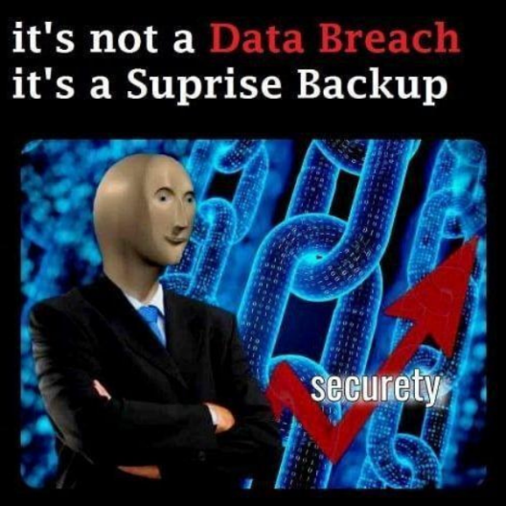

Takeaways
Trust- Trust as little as possible. We never know for sure how a user will interact with software
Intended Design- Users may interact with out system in ways that we did not think of.
Separation- There should always be a clear separation of code and data (user input)
Control Flow Hijack- There should not be any way for an attacker to hijack the “natural flow of things”
Privilege- Privilege is a very powerful mechanism. We should never give more privilege than needed
Usability- Security and software should be useable. Too much security will push people away

Slide 36
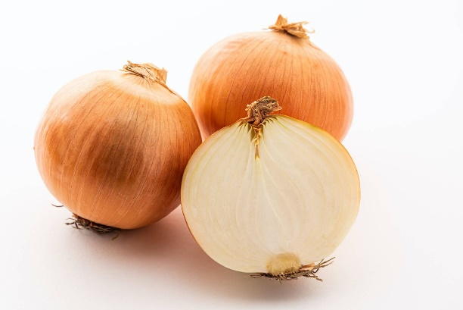
Takeaways
Trust- Trust as little as possible. We never know for sure how a user will interact with software
Intended Design- Users may interact with out system in ways that we did not think of.
Separation- There should always be a clear separation of code and data (user input)
Control Flow Hijack- There should not be any way for an attacker to hijack the “natural flow of things”
Privilege- Privilege is a very powerful mechanism. We should never give more privilege than needed
Usability- Security and software should be useable. Too much security will push people away
Layering- Security should be happening at multiple layers
(Firewall → Input Sanitization → Authentication → Antivirus Scanner)
Countermeasures exist, but are they effective? And are they enabled?

Slide 37


Takeaways
Trust- Trust as little as possible. We never know for sure how a user will interact with software
Intended Design- Users may interact with out system in ways that we did not think of.
Separation- There should always be a clear separation of code and data (user input)
Control Flow Hijack- There should not be any way for an attacker to hijack the “natural flow of things”
Privilege- Privilege is a very powerful mechanism. We should never give more privilege than needed
Usability- Security and software should be useable. Too much security will push people away
Layering- Security should be happening at multiple layers
There be monsters- Vulnerabilities exist, and there will always be people that will try to exploit them

Slide 38
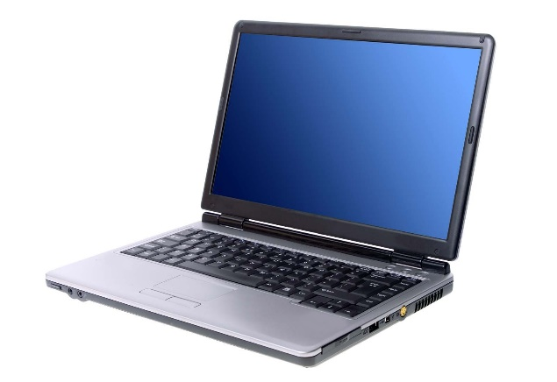


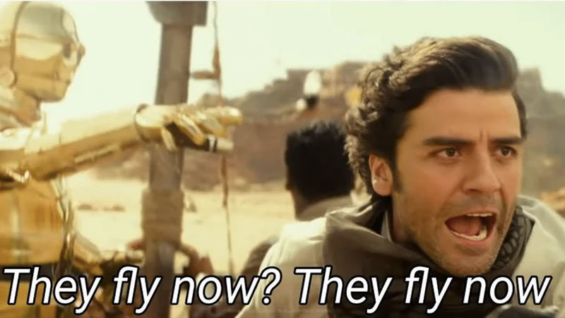
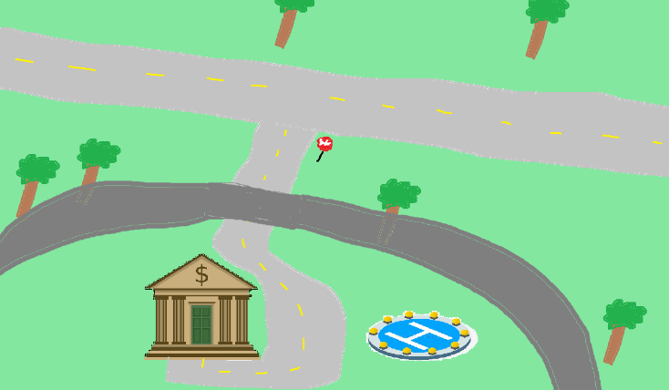
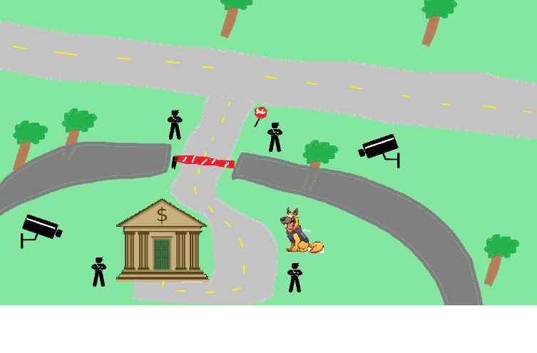

Perfect security is impossible
New assets
New threats
(ZERO days)
New capabilities
New technology

Slide 39
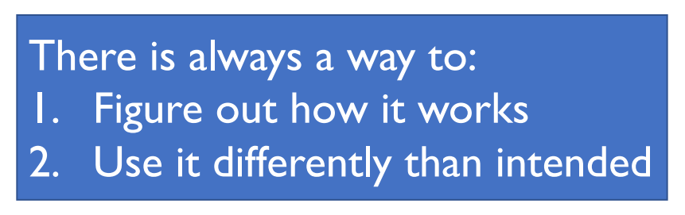
Takeaways
- Matt Revelle

Slide 40
Takeaways
Humans will always be the weakest link.
Social Engineering
Phishing
Writing bad code
Physical Security is also important

Slide 41
What’s next?
Cybersecurity Newsletters + Blogs
Dark Readings (https://www.darkreading.com/)
Schneier on Security (https://www.schneier.com/)
The Hacker News (https://thehackernews.com/)
Career skills for Cybersecurity:
https://roadmap.sh/cyber-security
Cybersecurity Certificate and trainings
CompTIA
Security+
CySa
SANS
ISC2
Be aware of new vulnerabilities (CVEs), new attacks, new countermeasures
Cybersecurity might seem scary to think about, but there are always good actors trying to make the cyber world a safe place
Cybersecurity-related Classes at MSU
CSCI 466 – Networks
CSCI 460 – Operating Systems
CSCI 351 – System Administration
ESOF 422- Advanced Software Engineering: Cyber Practices
CSCI 5XX – Intro to Malware

Slide 42
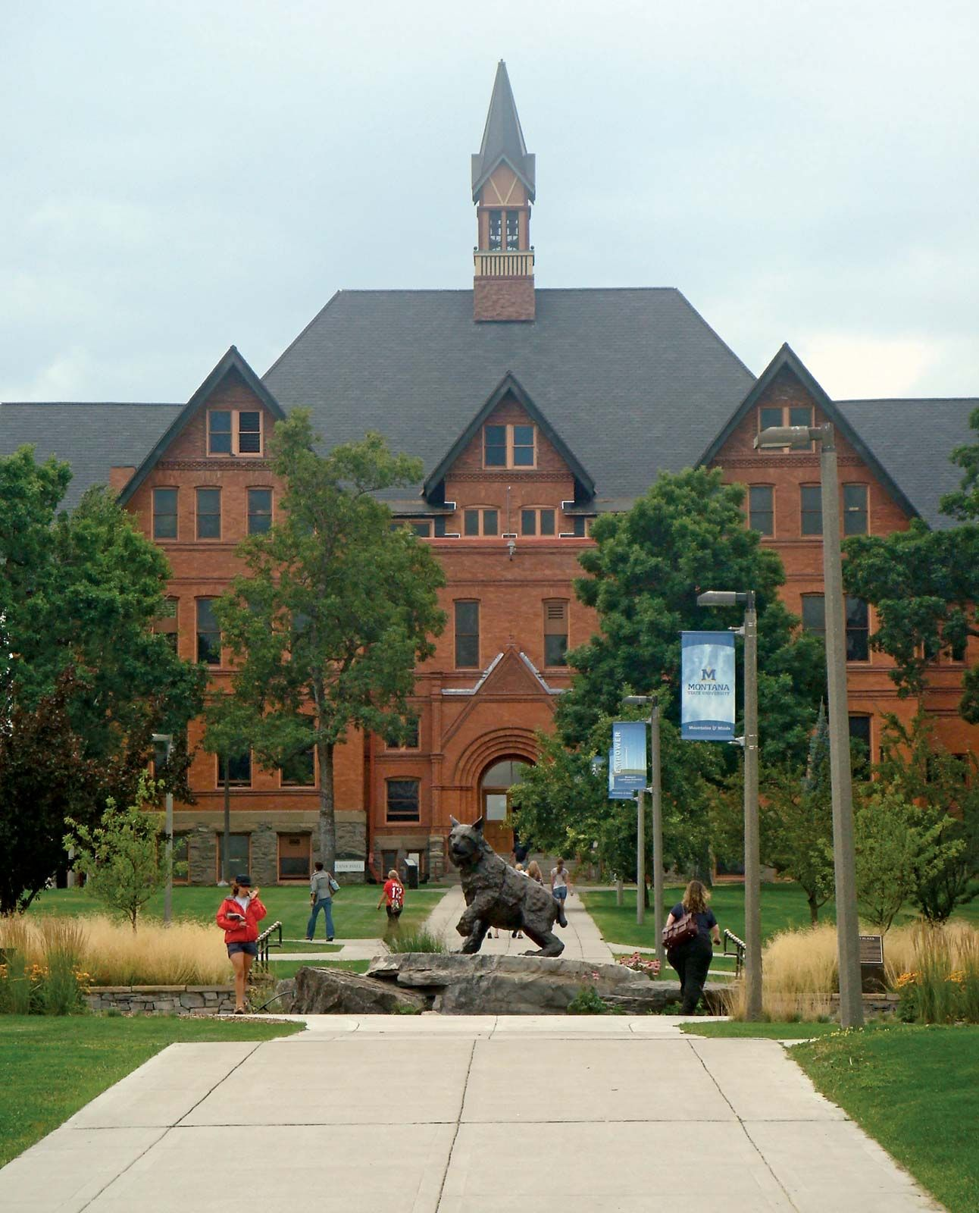
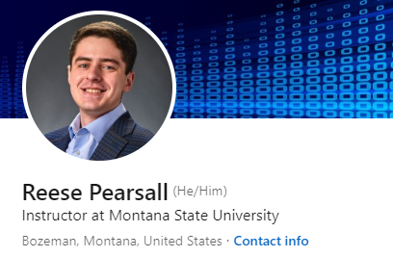

Thank You!
I hope you enjoyed this class, and I hope the stuff you learned will be helpful in your career/future classes
If I can be of assistance to you for anything in the future (reference, advising, support), please let me know!
I will be teaching CSCI 132/232 and ESOF 422 next semester
Connect with me on LinkedIn!
If you find a job in cybersecurity, please keep in touch!
Congrats to those that are graduating next weekend! I hope you find a job that you love!

